Slide 1
TESIA - S Class
Twitter Engagement for Stock Price Analysis - Sentiment Classification

Slide 2
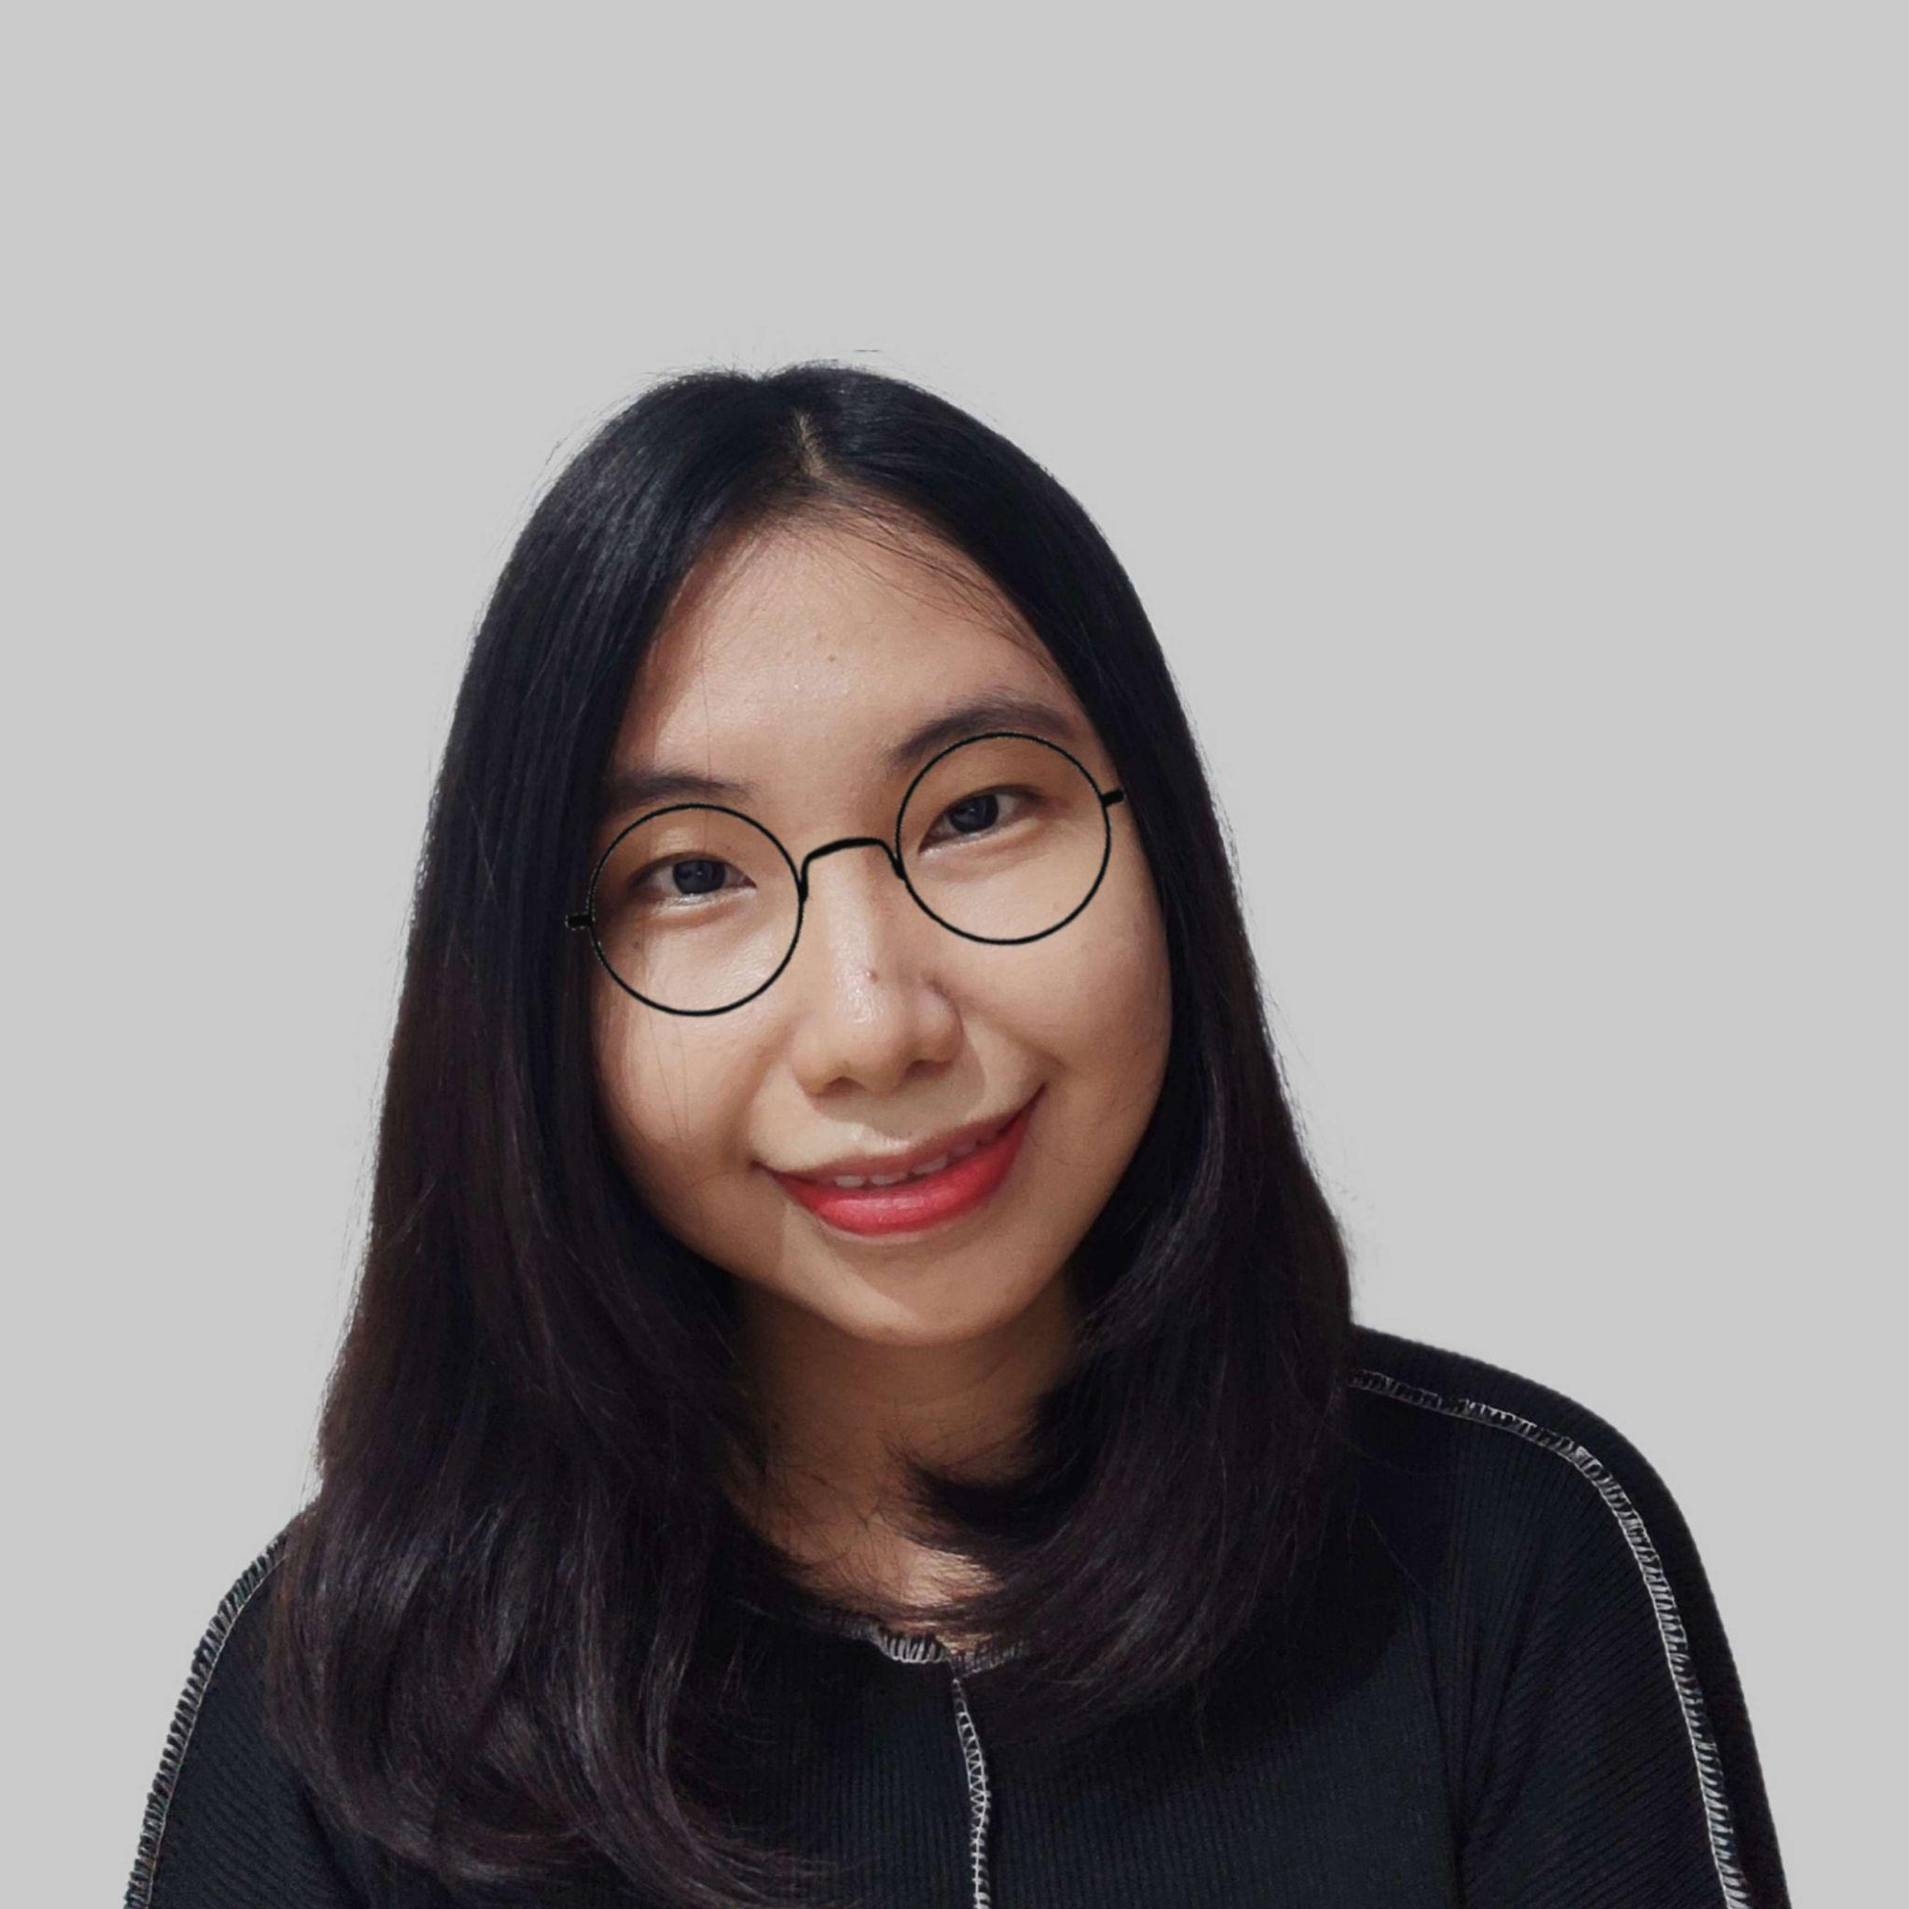
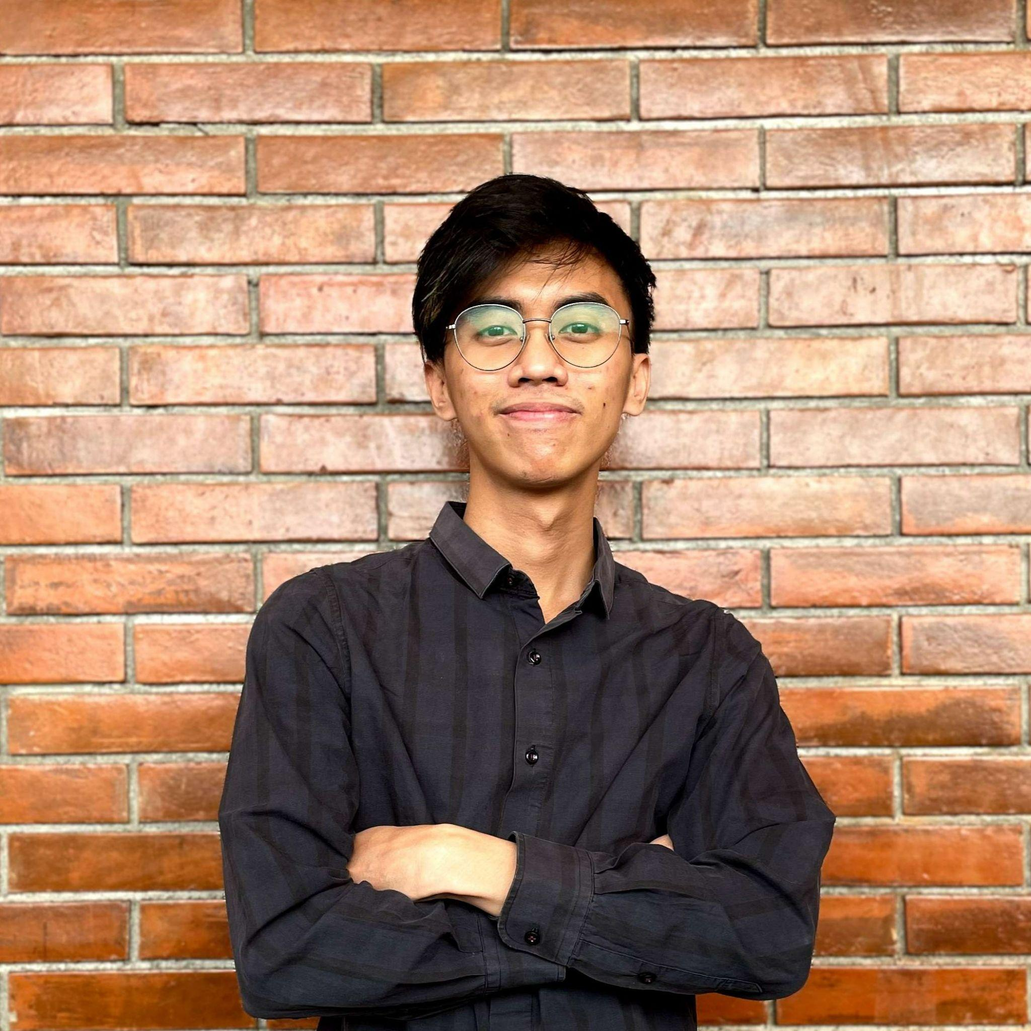
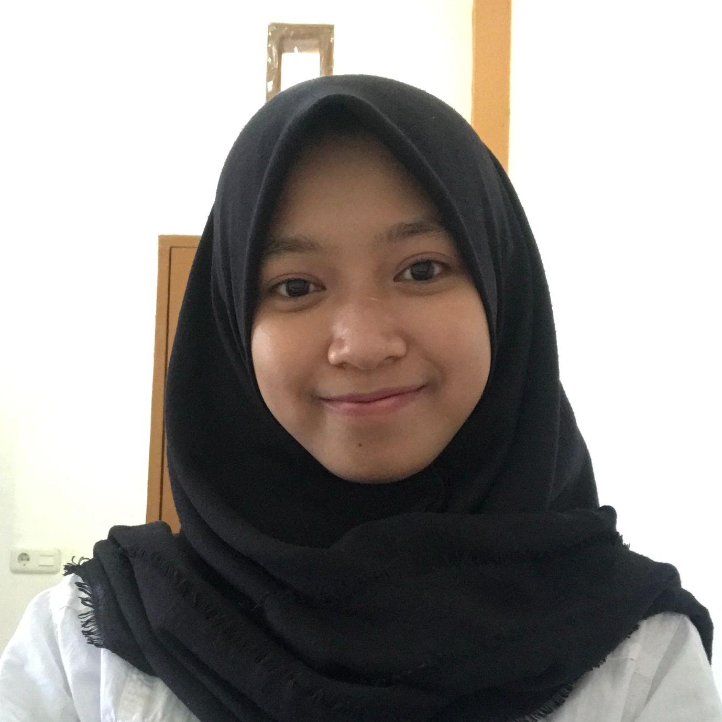

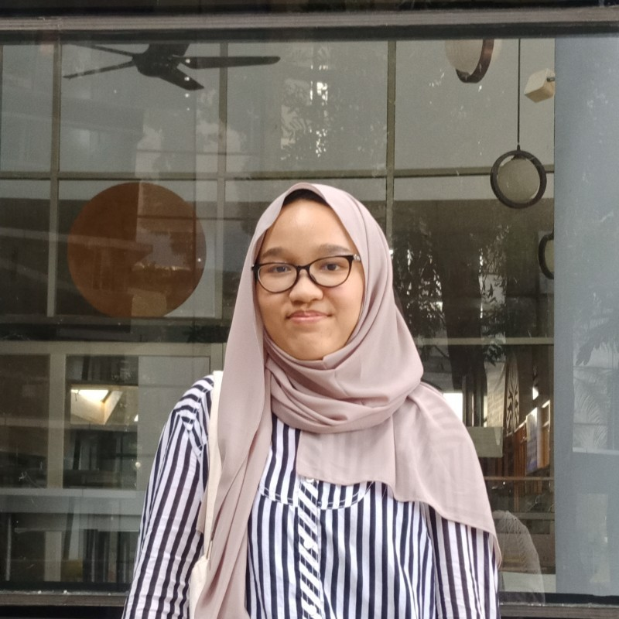
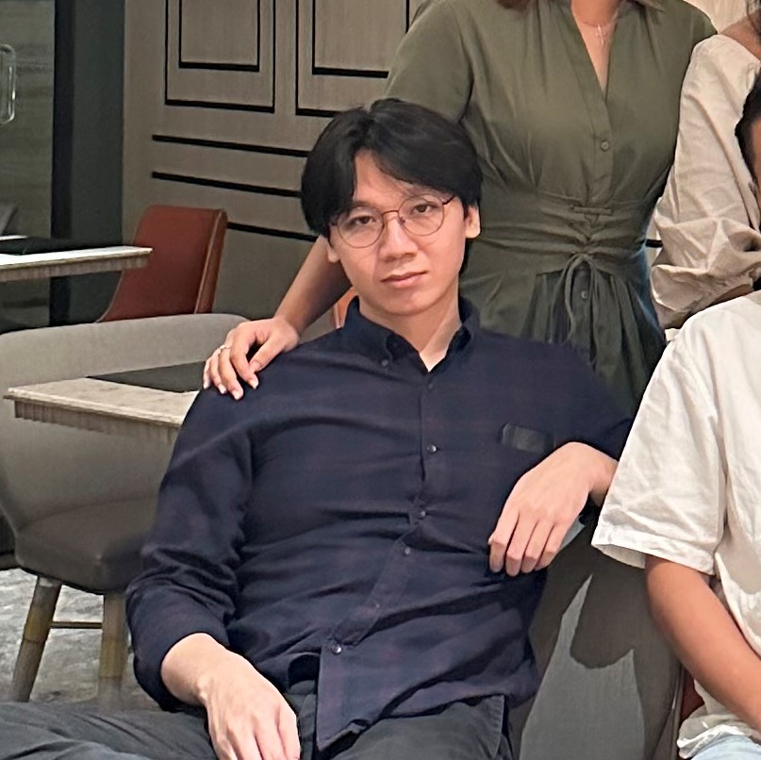
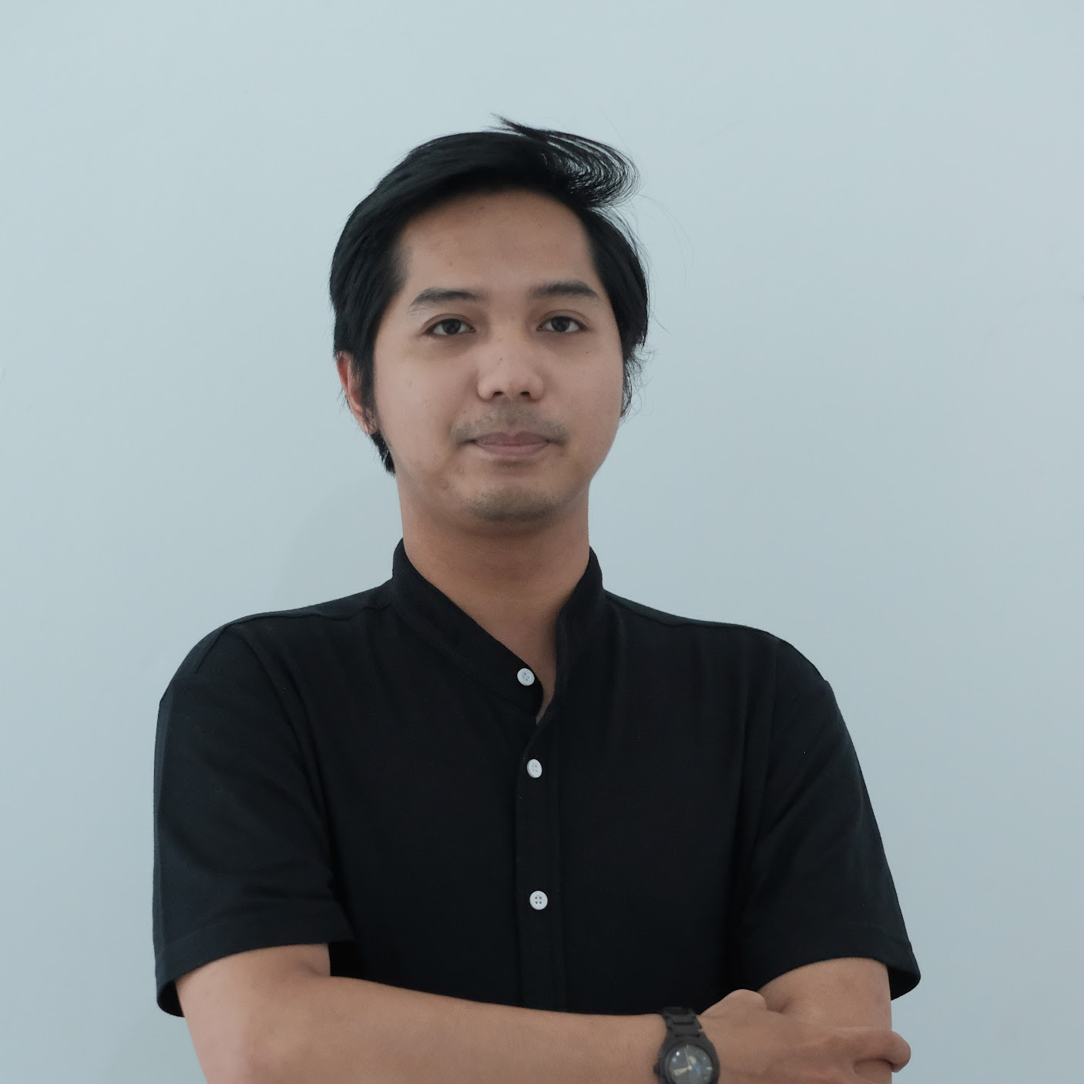
Group 3
Wenny C. Sari
Huesca Rashad
St. Syakirah
Irfan Hilman
https://www.linkedin.com/in/wennychandrasari/
https://github.com/WennyCS
https://www.linkedin.com/in/huescarashad
http://github.com/casheu
https://www.linkedin.com/in/st-syakirah
https://github.com/stsyaakirah
https://www.linkedin.com/in/irfan-hilman-0b28a1259/
https://github.com/IrfanHilman
Monica Pratiwi
Rivaldo Jasper
Venu Fitratama
https://www.linkedin.com/in/monica-mahardhika-pratiwi/
https://github.com/moncampr
https://www.linkedin.com/in/rivaldojasper/
https://github.com/RivJasper
https://www.linkedin.com/in/venufitratama/
https://github.com/venufitratama

Slide 3

“Financial specialists make decisions based on rumors wagering on the validity of the media that unveil them, indeed even though knowing that the information isn't continuously dependable.”
Cruz and Gomez, 2013.
de la Cruz FM, Gomes MYFS. 2003. The inuence of rumors in the stock market: A case study with Petrobras. Transinforma¸c˜ao, vol. 25, no. 3, pp. 187–193, 2013.
Notes:
For starters, Investors continue to play with the fears and desires to buy and sell. Especially in stock market itself.
Take a look at this quote from a publication written by Cruz and Gomez that said:
However, this trend is growing with the use of online social media networks such as Twitter, Facebook, Instagram or even YouTube.
Therefore, social media sentiment today has bigger impact towards market nowadays.

Slide 4
Indonesia experiences a strengthening of the financial sector
PT Bank Mandiri Tbk (BMRI)
BUMN
IDR
30 Trillion
PT Bank Rakyat Indonesia Tbk (BBRI)
PT Bank Negara Indonesia Tbk (BBNI)
PT Bank Tabungan Negara Tbk (BBTN)
CNBC - Indonesia
Notes:
The banking sector is the face of a country's economy which also attract the most attention. If this sector is doing well, it is more likely that the condition of the capital market will automatically improve in the future.
The state-owned bank or the bank with the greatest shareholding is the government currently dominates the Indonesian banking sector.
Based on the news from CNBC Indonesia in 2020, four State-Owned banks won the trust of Rp 30 trillion in placing funds from the government due to the strengthening of the financial sector index in trade driven by positive sentiment from within the country.
The four banks are PT Bank Mandiri Tbk (BMRI), PT Bank Rakyat Indonesia Tbk (BBRI), PT Bank Negara Indonesia Tbk (BBNI), and PT Bank Tabungan Negara Tbk (BBTN). This drove an increment in share costs at the four banks.

Slide 5


Which stocks do we need to purchase?
TESIA - S CLASS
TESIA - S CLASS
TESIA - S CLASS
Twitter Engagement for Stock prIce Analysis - Sentiment CLASSification (TESIA - S Class)
Notes:
On the off chance which stocks do we actually need to purchase? To help answering that question, we create a model, “Twitter Engagement for Stock prIce Analysis - Sentiment CLASSification (TESIA - S Class)” to make it less demanding to decide the stock to be acquired according to time series prediction and twitter sentimental classification.

Slide 6
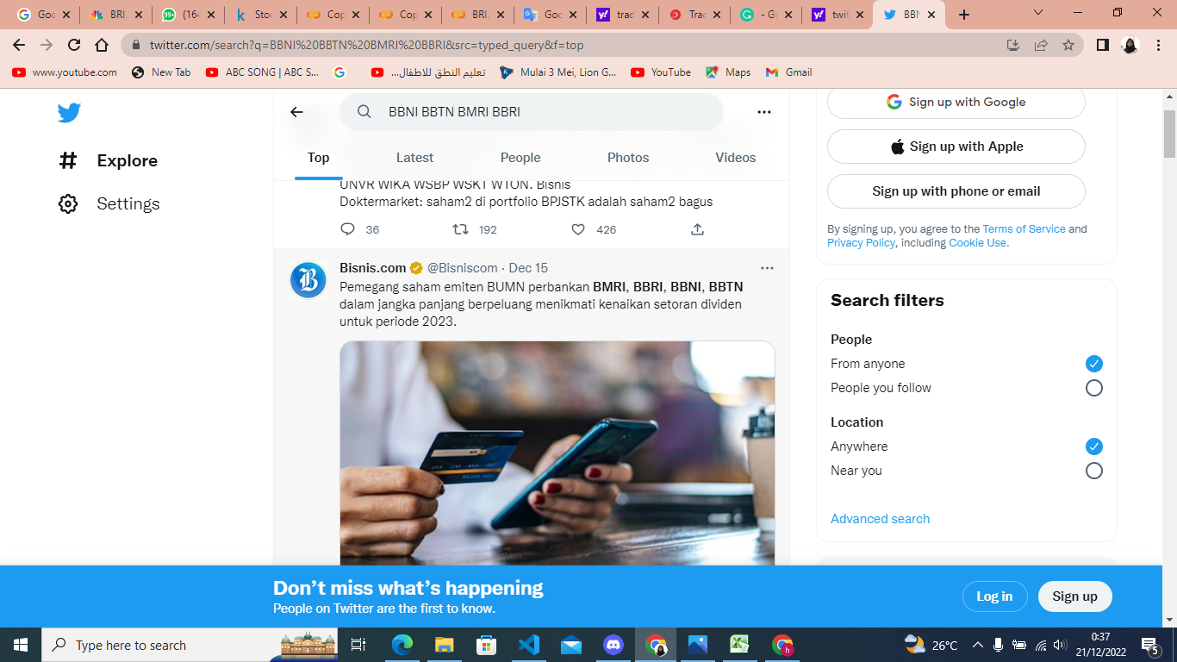
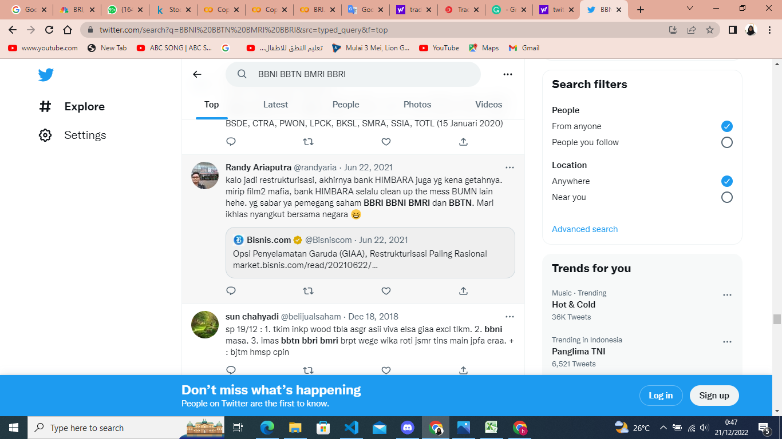
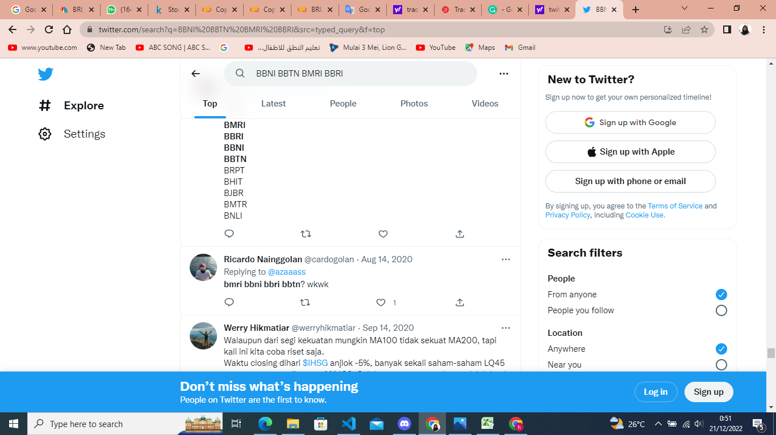
Twitter Sentiment
Notes:
We gather sentiments of the four banks from social media platform, namely Twitter

Slide 7
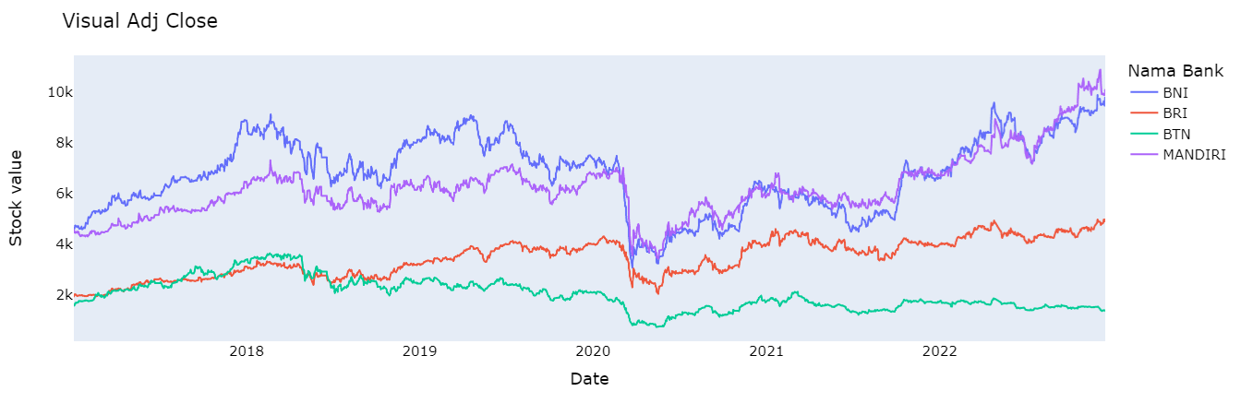
Change in price of the stock
Bank Name
Notes:
In this graph, we could see the changing of stock price of the four banks which the dataset are taken from yahoo finance, starting 2017 - 2022.
Stock price movements decreased for all banks in March 2020 due to the reduction of national transactions; which we also known caused by covid-19.
We could also see that BNI, BRI, Mandiri stocks movement are increased expect for BTN; and BNI and Mandiri are having higher stock price than BTN and BRI.

Slide 8
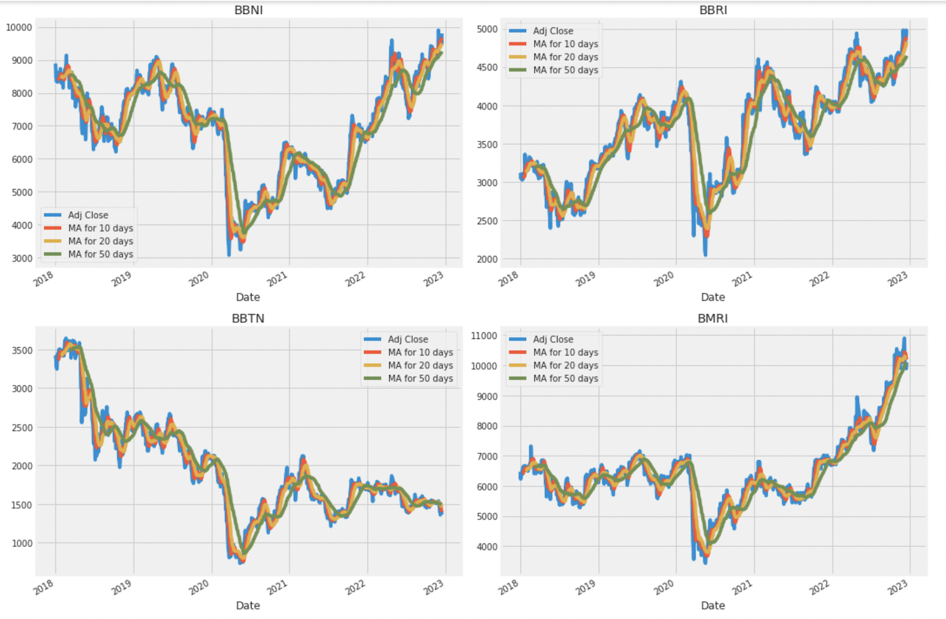
Moving Average
Notes:
Based on the information within the graph, the best values of time to measure the moving average are 10 and 20 days since we still capture patterns within the information without commotion.
XXX
[How Moving Average Works:
The moving average (MA) is a simple technical analysis tool that smooths out price data by creating a constantly updated average price. The average is taken over a specific period of time, like 10 days, 20 minutes, 30 weeks, or any time period the trader chooses.]

Slide 9
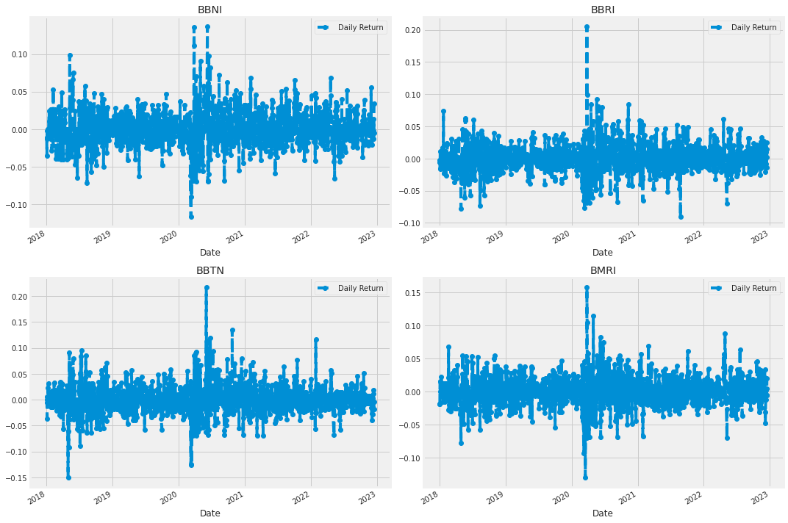
Daily Return on Average
Notes:
The daily return graph also showing a lot of instability by the sharp spike along the time period. Shown within the picture, the every day return dissemination has long overwhelming tail on both sides. Which implies speculators can be exceptionally beneficial or misfortune.

Slide 10
Roadmap
Sentiment from Social Media
Collect
Tweets
Labelling Tweets
Preprocessing
Build Sentiment Analysis Model
Predict Tweet Sentiment & Stock Prices
Model Deployment
Collect stock price from Yahoo Finance
Preprocessing
Build LSTM + GRU Model
Stock Price
Notes:
This is the process of how we produce the model
NLP (Natural Language Processing)
LSTM (Long Short Term Memory)
GRU (Gated Reccurent Unit)

Slide 11
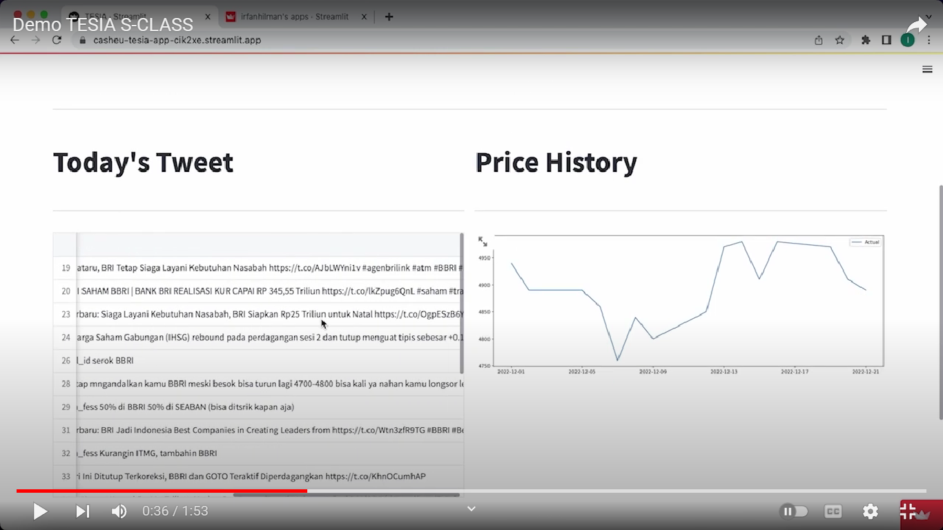
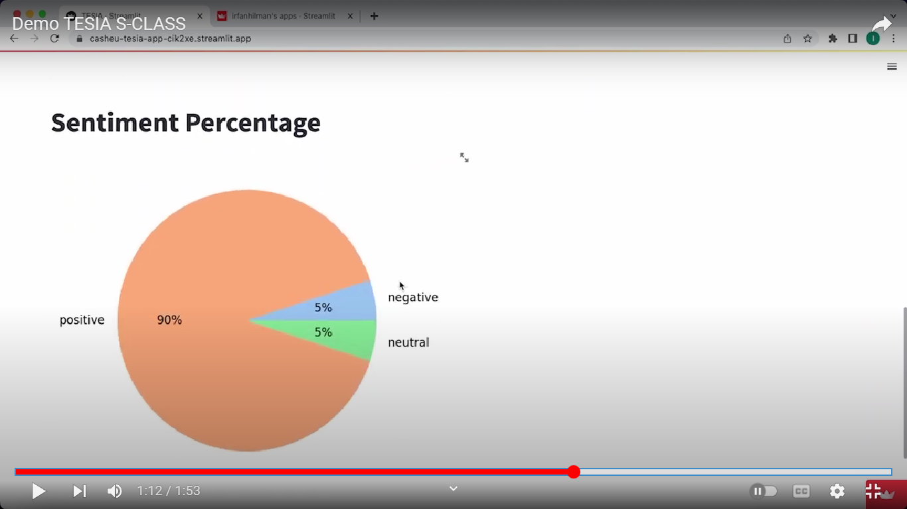
Tweet Sentiment Result

Slide 12
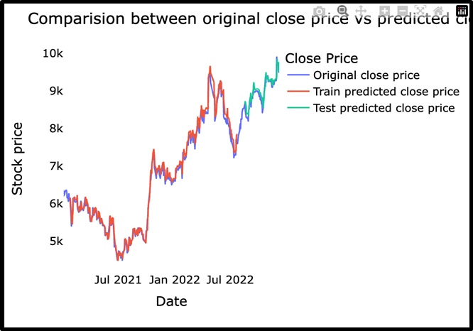
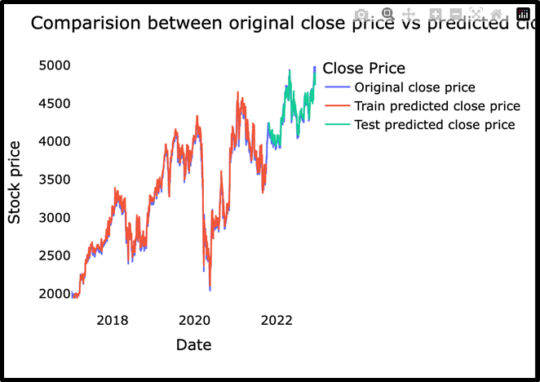
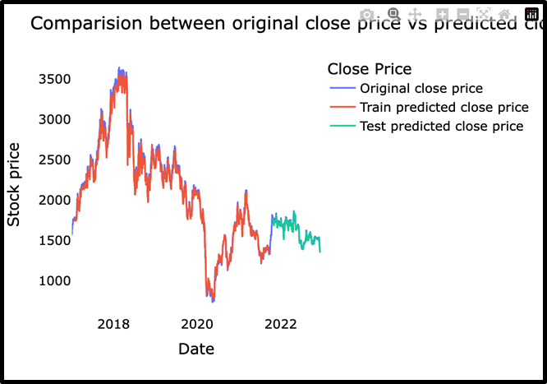
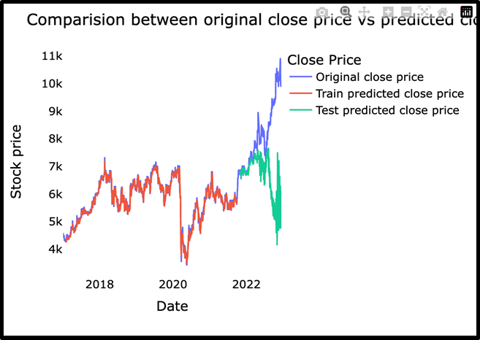
S
T
O
C
K
P
R
I
C
E
BBNI
BBRI
BBTN
BMRI

Slide 13
Advantages
Our NLP model uses manual labelling for training datasets.
The time series model generally predicts stock prices well with low errors, shown by the previous graph.

Slide 14
Drawbacks
Our NLP model uses limited amount of datasets (~ 1000 tweets) due to limited time for labelling activity.
Model improvements are still needed.
Time series model is still not good to predict the stock price of MRI.

Slide 15
Constrains
The tweets use Indonesian language that contain many slang words
Prediction is limited to only four state-owned banks stock.

Slide 16
Improvements
Add more tweet datasets
Add more stocks
Add the prediction probability for stock price

Slide 17
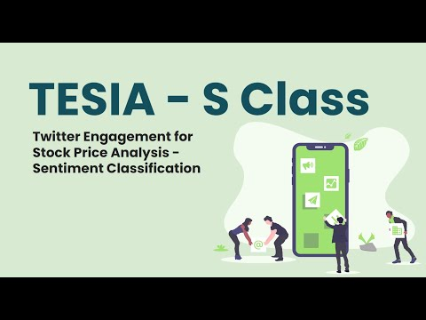
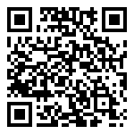
Demo

Slide 18

Thanks!
Any Questions?

Slide 19
Wenny C. Sari
Huesca Rashad
St. Syakirah
Irfan Hilman
https://www.linkedin.com/in/wennychandrasari/
https://github.com/WennyCS
https://www.linkedin.com/in/huescarashad
http://github.com/casheu
https://www.linkedin.com/in/st-syakirah
https://github.com/stsyaakirah
https://www.linkedin.com/in/irfan-hilman-0b28a1259/
https://github.com/IrfanHilman
Thank
You!
Monica Pratiwi
Rivaldo Jasper
Venu Fitratama
https://www.linkedin.com/in/monica-mahardhika-pratiwi/
https://github.com/moncampr
https://www.linkedin.com/in/rivaldojasper/
https://github.com/RivJasper
https://www.linkedin.com/in/venufitratama/
https://github.com/venufitratama

